Slide 1
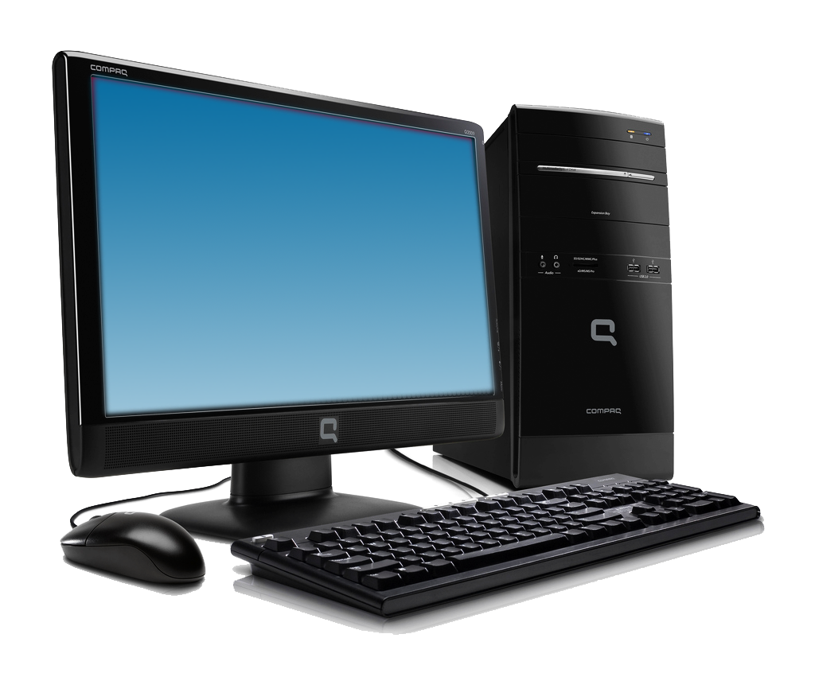
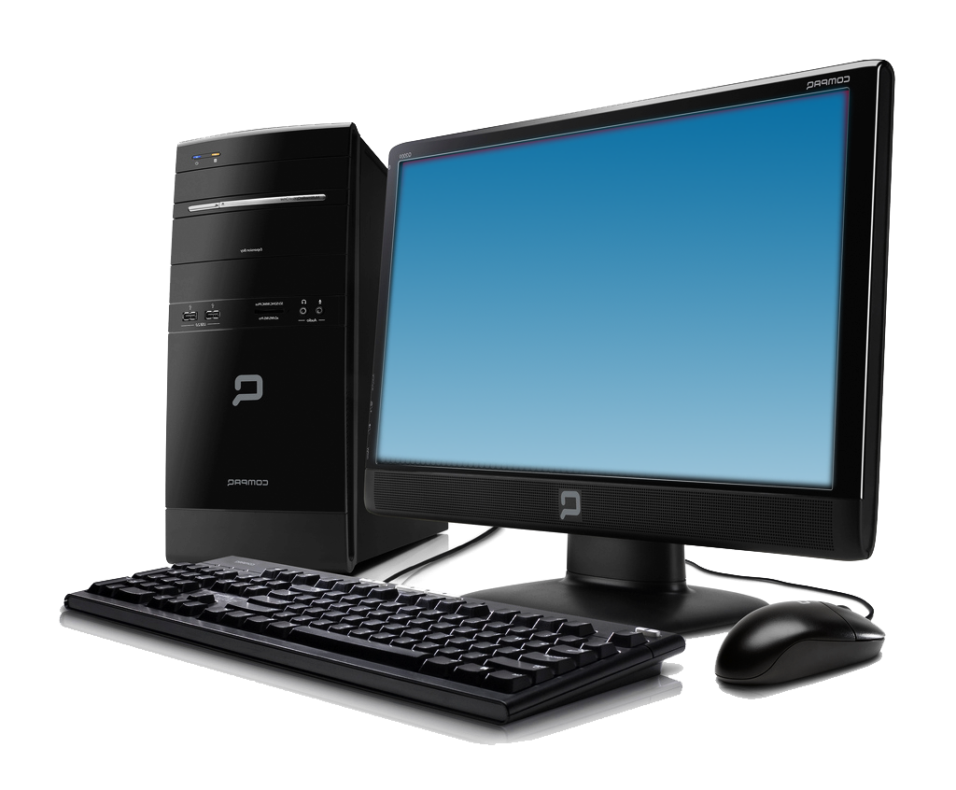


Data Communication & Networking
Data Communication is exchange of data between two devices , via any transmission media

Slide 2
Communication Model
Destination System
Destination
Receiver
Transmission System
Source System
Output Information
(Exact copy of Original Message)
Transmitter
Source
Output Data
(sequence of bits)
Received Signal
Transmitted Signal
Input data
(Sequence of voltage shifts)
Input
Information
(Message)
Communication System Shows the Exchange of Data between two parties.

Slide 3
TRANSMISSION MEDIA
Mode of communication, through which signal is carried from one system to another
Two Major Classes
Guided Media
Unguided media

Slide 4
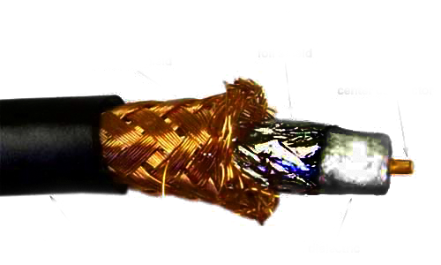
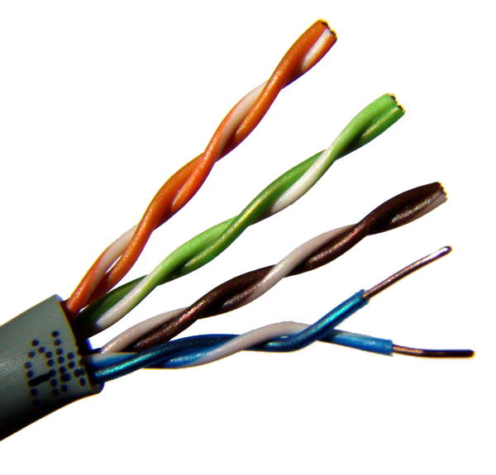
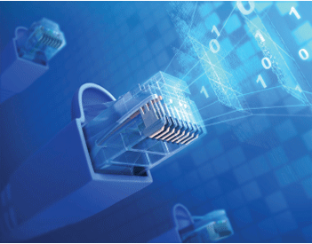
Guided Media
Outer Jacket
Dielectric
Twisted Pair
Center Conductor
Braided shield
Foil Shield
UTP cat5 Cable
Coaxial Cable
Color coded plastic insulation
Outer Jacket
RJ-45 Connector
Guided Transmission media uses a cabling system that guides the data signals along a specific path. The data signals are bound by the “Cabling” system.

Slide 5
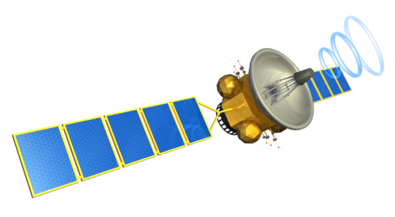
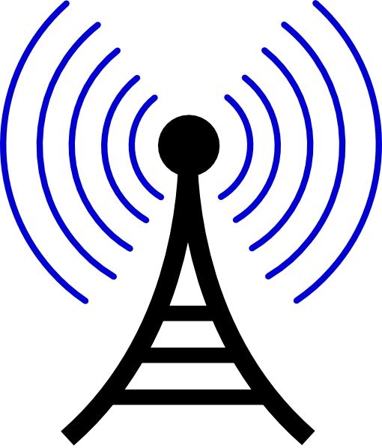
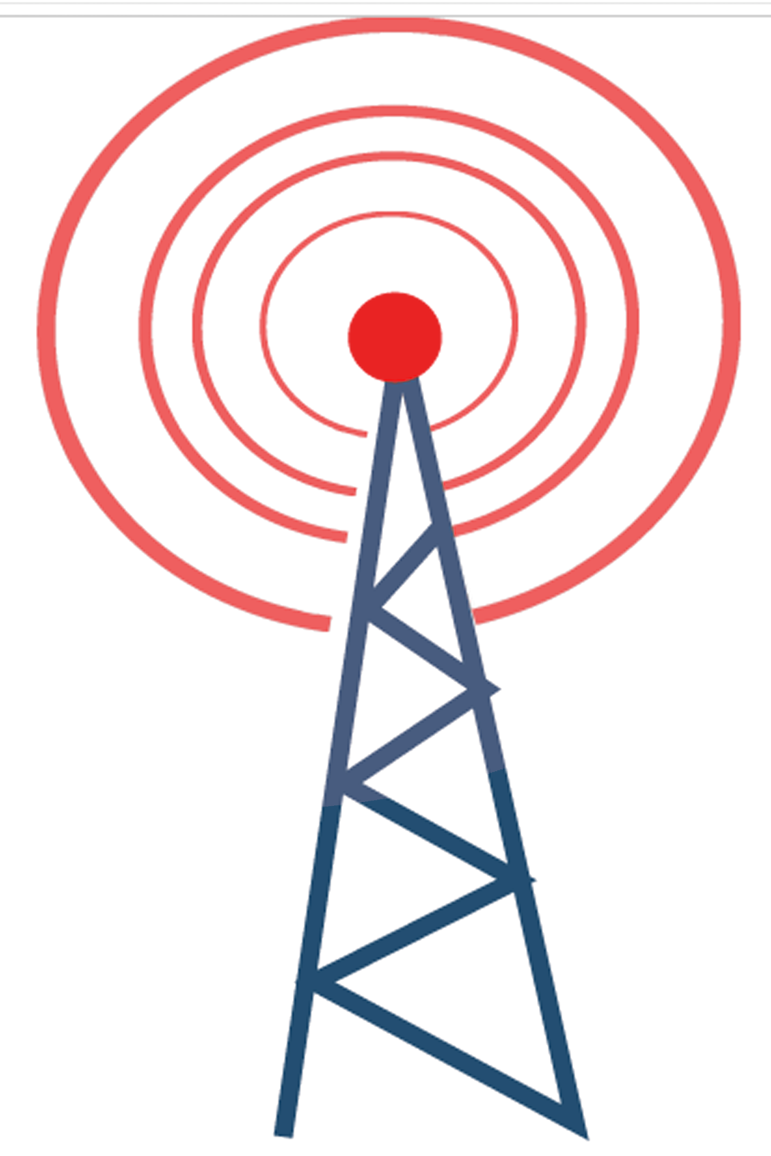

Un-guided media
Space and satellite communications, Microwave system
Wireless networking system.
Cellular Phones, navigational aids, global positioning system.
Radio Astronomy, Radar Landing system.
The unguided media is the wireless media. It transports electromagnetic waves without using any physical conductor. Signals are normally broadcast through the air and thus are available to any one who has the device capable of receiving them.

Slide 6
OSI
Reference Model
The OSI model is a set of guidelines that describes the process that should take place when two computers communicate on a network.

Slide 7

The OSI Model Stack
This is the level that the user often interacts with
The Presentation Layer is where the
human readable programming languages are
transport layer to create and control
Application layer
Upper layers
translated into machine code instructions
conversations (or sessions) between
Presentation layer
two computers
It keeps track of the packet’s order &
the packets that must be re-sent.
The network layer breaks large
Session layer
Two transport protocols, TCP and UDP,
datagrams into smaller packets
The
sits at the transport layer
Internetwork Protocol identifies each host
Data Link layer provides error
Transport Layer
with a 32-bit IP address
Free transfer of data frames
Lower layers
From one PC to another
Network Layer
Physical layer defines the
over a Physical layer
relationship between a device and
Data Link Layer
a transmission medium
Physical Layer
The open system interconnection (OSI) model divides the complex task of internetworking, into a series of stages known as layers.

Slide 8

Working OSI model
Application layer
Application layer
Presentation layer
Presentation layer
Session layer
Session layer
Transport Layer
Transport Layer
Network Layer
Network Layer
Data Link Layer
Data Link Layer
Physical Layer
Physical Layer
As data is being sent from one computer, it will pass from the top layer to the bottom. On the receiving , the data will then be rebuilt from the bottom layer to the top.

Slide 9
Physical Layer
If network cable is plugged in?
Data Link Layer
Do you have a link light?
Network Layer
Are you getting an IP?
Can you ping default gateway?
Session layer
Do you have DNS server information?
Presentation layer
What format is the graphic in? Do you have a viewer for that format?
Application layer
Can your web browser open up another website?
Transport layer
Can you ping 4.2.2.2 but not google.com?
Application of OSI model
OSI protocol suite is currently not applied to any Computer Network Protocol, but it is used to create protocol suites like TCP/IP
Although this suite is not applied to any computer network but still some network administrators uses this model as a guidance for troubleshooting, whenever the network is down.

Slide 10
TCP / IP
Reference Model

Slide 11
TCP / IP Layers
Application
Layer
Application layer defines host programs interface with transport layer services to use the network.
Transport Layer provides data exchange reliability i.e. data arrive at the destination application and data arrive in the same order in which they were sent.
The TCP and UDP are most commonly used protocols in this layer.
Transport Layer
...
Internet Layer
Internet layer Internet layer pack data into data packets known as IP datagrams
Network Access Layer
Network Access layer defines details of how data is physically sent through the network. and how they interact with physical medium
Physical Layer
Physical Layer covers the physical interface between a data transmission device and a transmission medium or network.
TCP/IP stands for Transmission Control Protocol/Internet Protocol . It is a set of rules / protocols that transfer the data between computers.
The purpose of TCP is to verify whether the data is transferred from a client to the sever.
The purpose of IP is to move packets of data from mode to mode.

Slide 12

Working Of TCP / IP Layers
Application
Layer
Transport Layer
Internet Layer
Network Access Layer
Physical Layer
As data is being sent from one computer, it will pass from the top layer to the bottom. On the receiving end, the data will then be rebuilt from the bottom layer to the top.
Each layer a packet of information travels through adds what is called a header. each layer a sending packet passes through gains another header . When the packet is being rebuilt on the receiving end, each header is unpackaged the same way

Slide 13
HTTP
FTP
SMTP
DNS
RIP
SNMP
Application layer
SSL
ASCII
Application
Layer
Presentation layer
?
Sockets
NetBIOS
Session layer
TCP
UDP
Transport Layer
Transport Layer
IPv4
IPv6
...
IGMP
ICMP
ND
MLD
Internet Layer
Network Layer
ICMPv6
ARP
Ethernet
802.11
Wireless LAN
Frame Relay
ATM
Network Access Layer
Data Link Layer
Hardware
Physical Layer
Physical Layer
Comparison of osi & tcp/ip protocol architecture

Slide 14
Network Types
There are many types of networks which are used world wide these days, both in houses and commercially. These networks are used on the bases of their scale and scope, historical reasons, preferences for networking industries, and their design and implementation issues. LAN and WAN are mostly known and used widely.

Slide 15
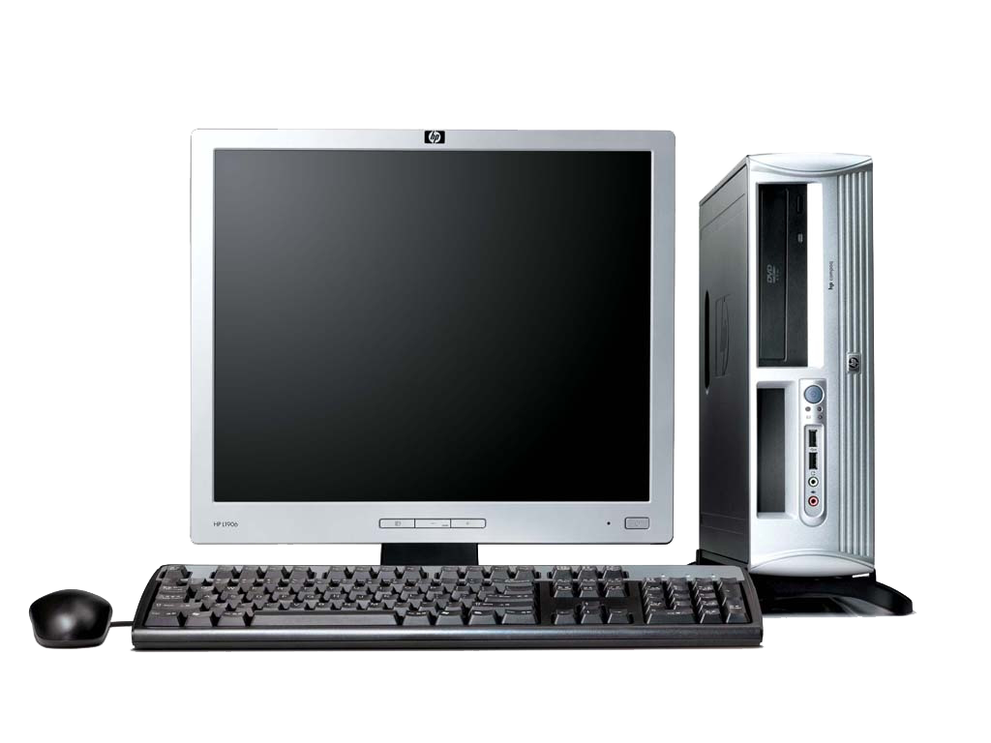

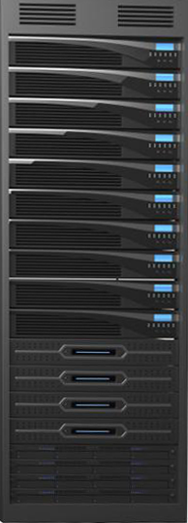
LAN- Local Area Network
2 Types
A local area network (LAN) is a computer network that interconnects computers in a limited area such as a home, school, computer laboratory, or office building using network media.

Slide 16
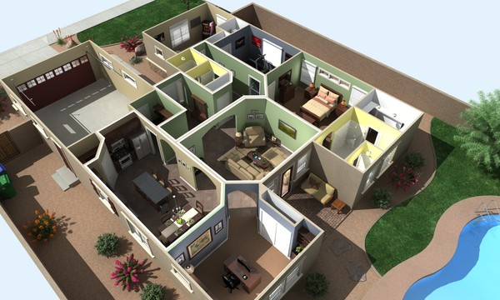
1- HAN – Home Area Network
Study
Laptop
Internet
Office
Home area network (HAN) is a residential local area network (LAN) for communication between digital devices typically deployed in the home, usually a small number of personal computers and accessories, such as printers and mobile computing devices. An important function is the sharing of Internet access

Slide 17
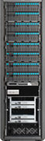
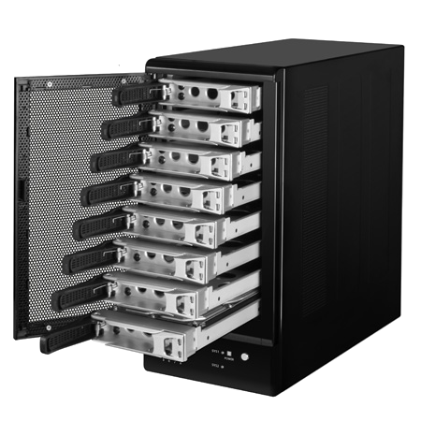
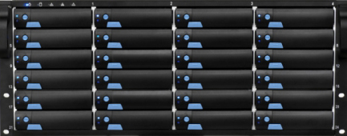
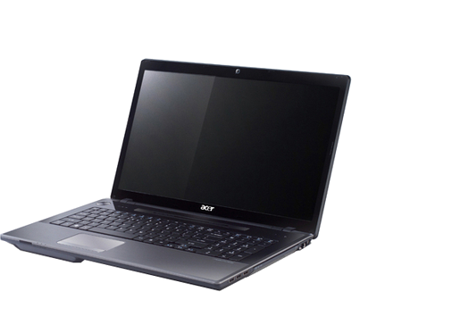
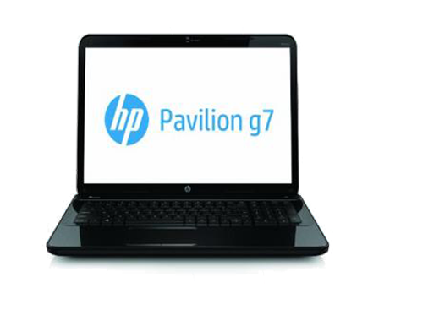
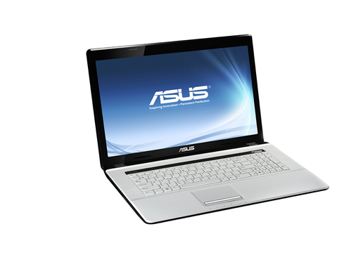
2- SAN - Storage Area Network
Disk Array
JBOD
RAID
[ redundant array of independent disks]
Server
SAM technology is used for data storage and it has no use for most of the organization but data oriented organizations. Storage area network connects servers to data storage devices by using Fiber channel technology.

Slide 18
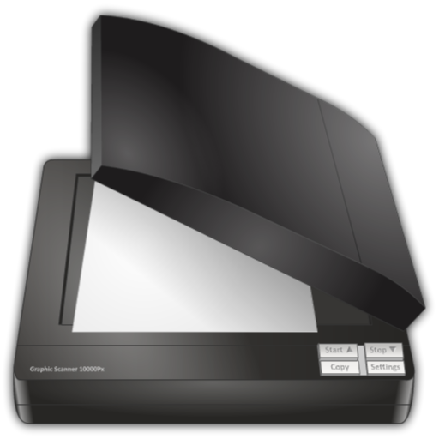
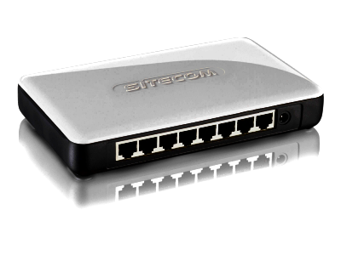
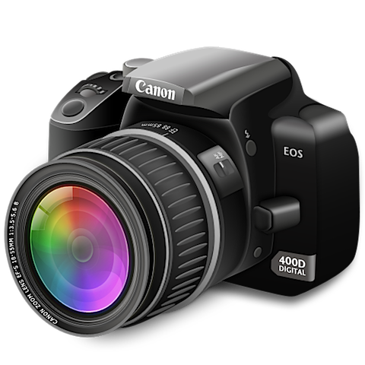


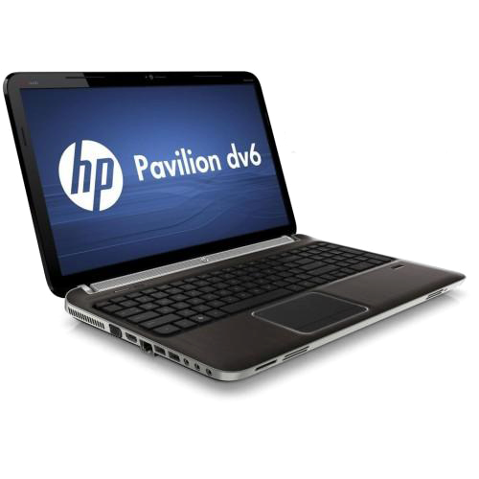
PAN – Personal Area Network
Internet
Personal area network (PAN) is a computer network designed for communication between computer devices (including telephones and personal digital assistants close to one person).

Slide 19
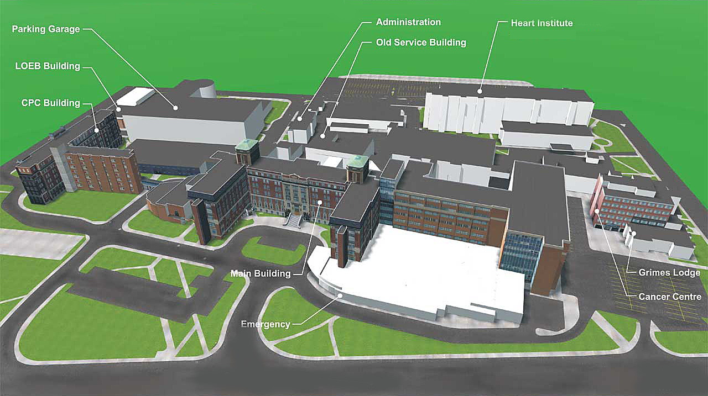
CAN - Campus Area Network
Networking spanning with multiple LANs but smaller than a Metropolitan area network, MAN. This kind of network mostly used in relatively large universities or local business offices and buildings.

Slide 20
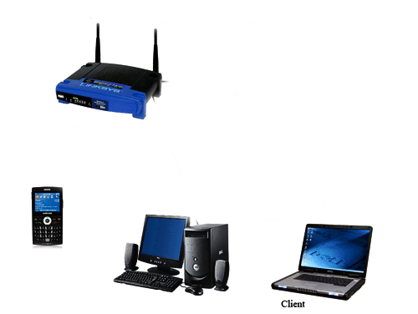
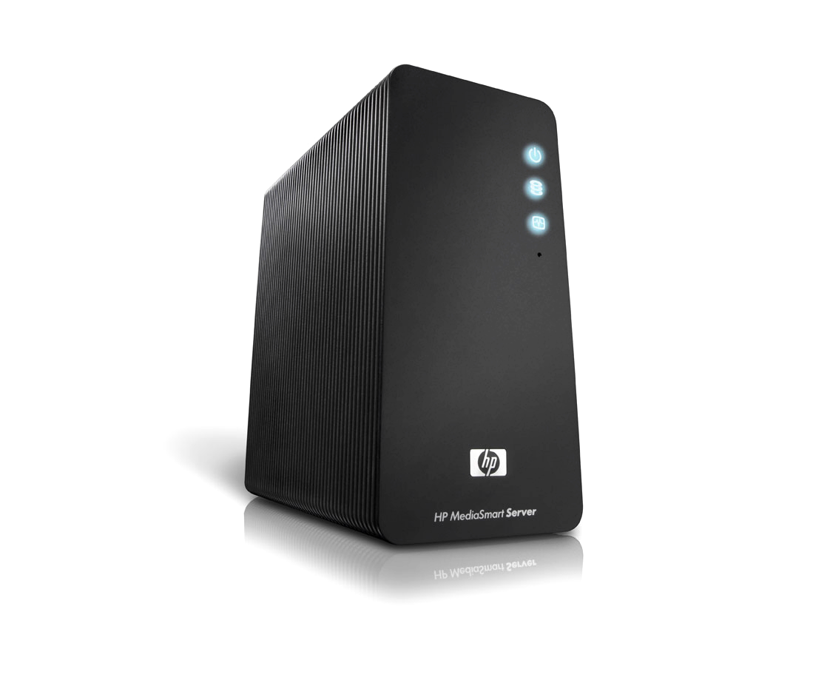
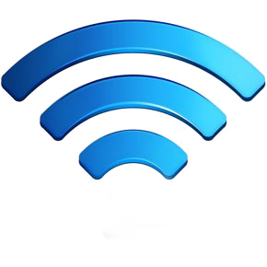
WLAN
A LAN based on Wi-Fi wireless network technology

Slide 21
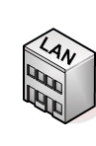

MAN - Metropolitan Area Network
City
This kind of network is not mostly used but it has its own importance for some government bodies and organizations on larger scale. MAN, metropolitan area network falls in middle of LAN and WAN, It covers large span of physical area than LAN but smaller than WAN, such as a city.

Slide 22


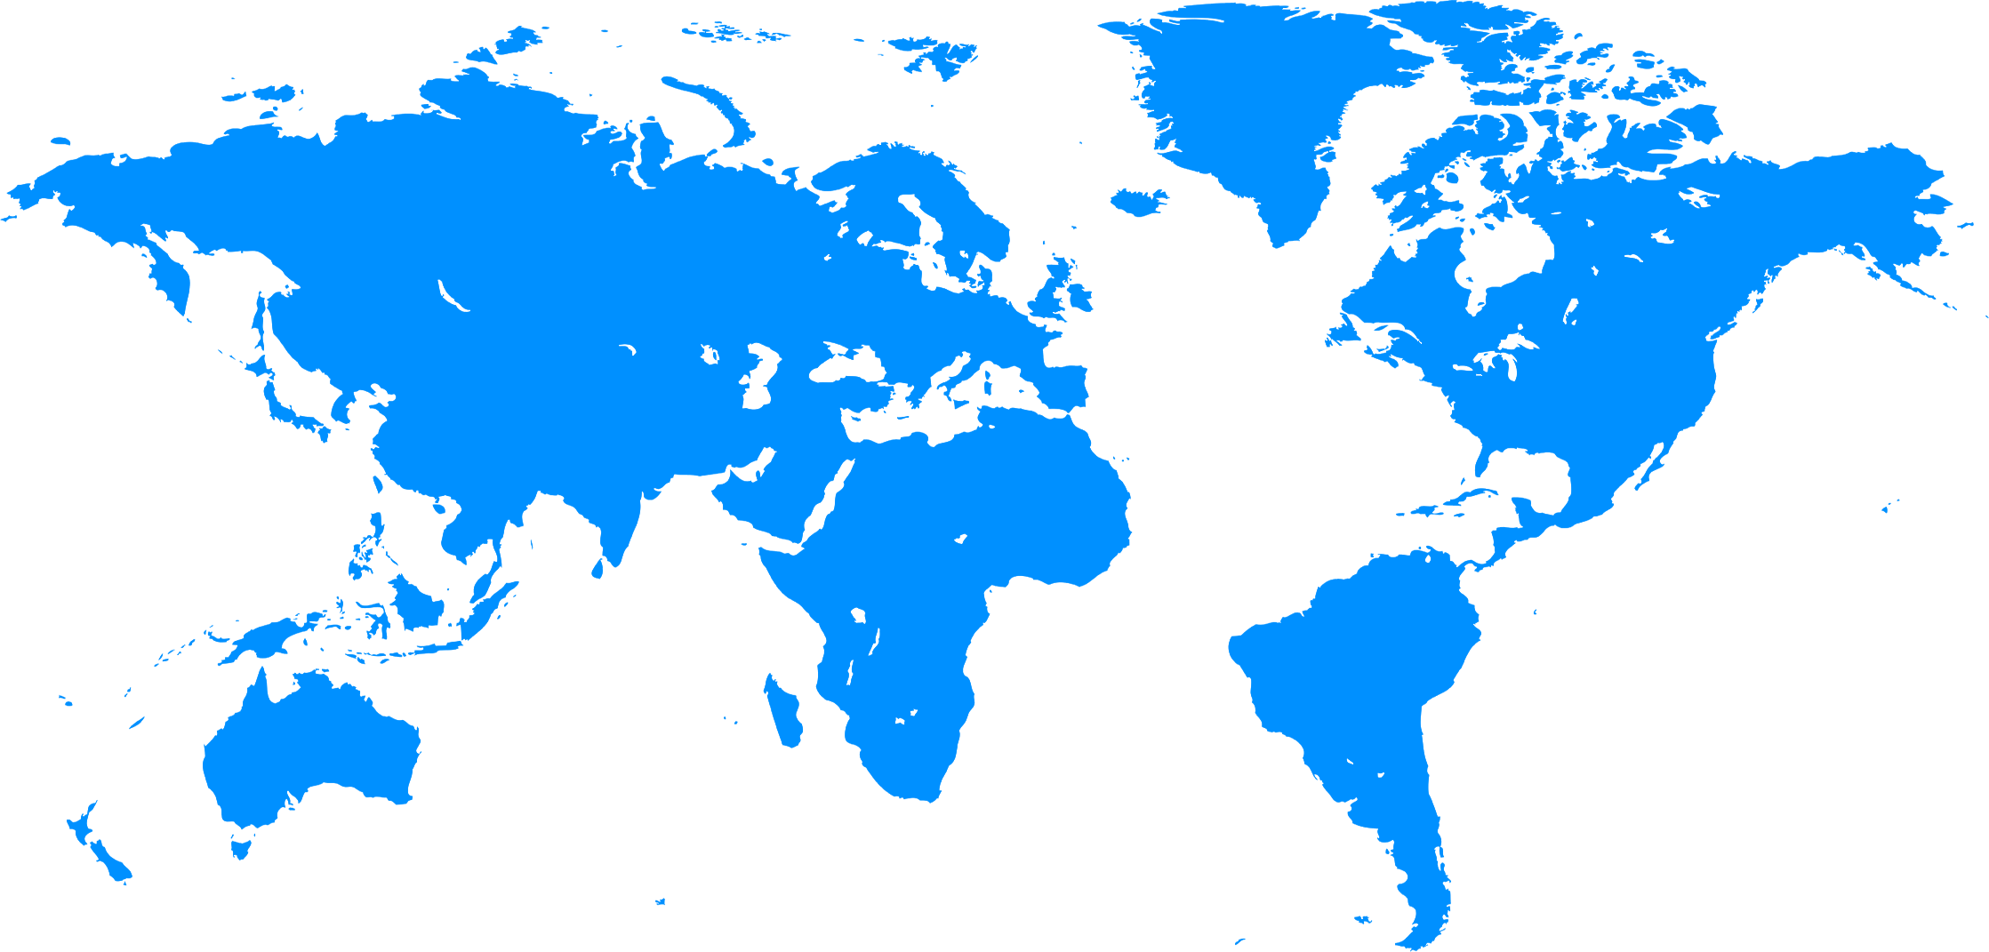
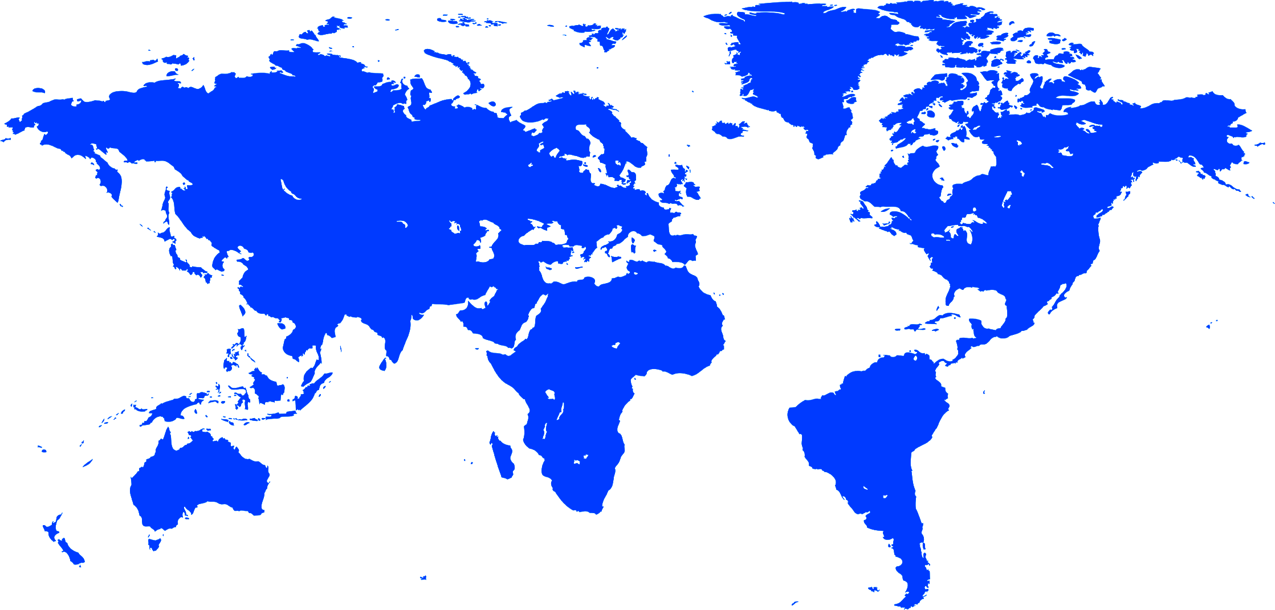
WAN - Wide Area Network
?
WAN is a geographically-dispersed collection of LANs. A network device called a router connects LANs to a WAN. In IP networking, the router maintains both a LAN address and a WAN address.
A WAN differs from a LAN in several important ways. Most WANs (like the Internet) are not owned by any one organization but rather exist under collective or distributed ownership and management. WANs tend to use technology like ATM, Frame Relay and X.25 for connectivity over the longer distances.

Slide 23


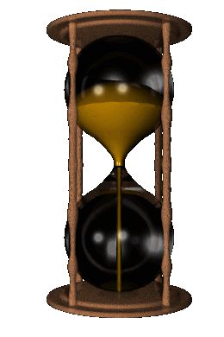
Circuit Switching
Circuit establishment data transfer Circuit disconnect
Network Technologies
Exchange
Exchange
Exchange
Exchange
The most common example of circuit-switching is telephone network
In Circuit-switching, a dedicated communication path is established between two stations through the nodes of network
Circuit switching are ideal for communications that require data to be transmitted in real-time.
Disadvantage Of Circuit Switching

Slide 24
Packet Switching
1
3
2
Internet
Upper bound on packet length is 1000 bytes
3
2
1
In packet-switching data is sent out in a sequence of small chunks, called packets.
Packet-switching networks are more efficient if some amount of delay is acceptable
Priorities can be used. If a node has a number of packets for transmission.
Can perform Data-rate conversion. So two Pcs on different data-rates can exchange data

Slide 25

Packet Switching techniques
2- Virtual Circuit
1-Data Gram
1
2
3
3
1
2
Each Packet is treated independently without any reference of order. So they may not follow the same route or may arrive out of sequence
The destination will do re-ordering of packets and recover lost packets
A preplanned route is set before any packet is sent
All packets follow the same route so they arrive at same order

Slide 26
X-25
2
1
3
Uses the virtual circuit approach
A set of international protocols approved
The redundant error checking is done at each node

Slide 27
Frame relay
4
3
2
1
Frame 3
Frame 2
Frame 1
F1
F2
Frame Relay is based on the old X.25 packet-switching technology
Frame Relay puts data in a variable-size unit called a frame
Link-to-link reliability is not provided – if a frame is corrupted, it is silently discarded
Frame relay was developed to take advantage of high data rates and low error rates of packet-switching.
Unlike X.25 frame relay is a fast packet technology, which means that the protocol does not attempt to correct errors

Slide 28
atm
A Cell of fixed size of 53 byte
C1
C2
Improves on performance of Frame Relay
Based upon 53-byte cells of fixed size
Compatible with twisted-pair, coax, and fiber

Slide 29
TOPOLOGIES
In computer networking, topology refers to the layout of connected device

Slide 30
Topologies types
Network topologies are categorized into the following basic types:
Bus
Ring
Star
Tree
Mesh

Slide 31
BUS -Topology
Data for PC-4
Data Received
A single cable, is established as a shared communication medium on which devices are attached
Terminators are attached on both ends
A device wanting to communicate with another device on the network sends a broadcast message onto the wire that all other devices see, but only the intended recipient actually accepts and processes the message.
Suitable for broadcasting.
CSMA/CD (carrier sense multiple access/collision detection) And CSMA/CA (carrier sense multiple access/collision avoidance), techniques are used to avoid collision of data.

Slide 32
Star -Topology
1
Msg to pc 4
2
4
Switch
HUB
3
A star network features a central connection point called a hub node OR Switch ..
If it is a Hub, the Msg will be broadcasted to every system
If it is a Switch the Msg will be allocated a buffer memory in which destination address would be stored and msg would be forwarded to the destination only
Compared to the bus topology, a star network generally requires more cable, but a failure in any star network cable will only take down one computer's network access and not the entire LAN

Slide 33
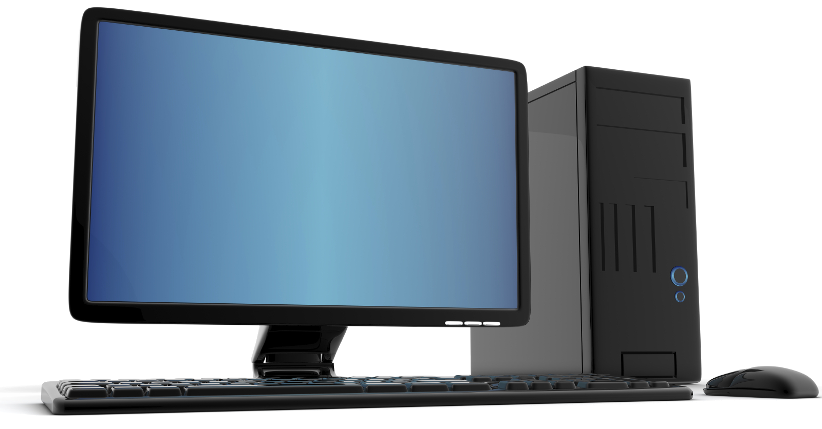
Tree -Topology
Data 1 to 5
1
6
7
2
4
3
5
Multiple Bus topologies together
Same working as Bus topology
Supports future expandability
Attenuation.

Slide 34
Ring -Topology
Sender is terminator
1
Msg for PC-4
4
2
3
All messages travel through a ring in the same direction (either "clockwise" or "counterclockwise").
Attenuation is solved as each Pc is a repeater

Slide 35
Ring -Topology
MSAU
Rin Rout
Rin Rout
Rin Rout
Rin Rout
Msg to pc 2
3
2
1
All messages travel through a ring in the same direction (either "clockwise" or "counterclockwise").
Attenuation is solved as each Pc is a repeater
Logically Ring, but physically Star
A failure in any cable or device breaks the loop and can take down the entire network.

Slide 36
Mash -Topology
?
Partial Mash
Full Mash
Mesh topologies involve the concept of routes.
Unlike each of the previous topologies, messages sent on a mesh network can take any of several possible paths from source to destination.
partial mesh networks also exist in which some devices connect only indirectly to others.
A mesh network in which every device connects to every other is called a full mesh. As shown in diagram. In Full mesh each device has n-1 connections.

